Slide 1
HFNY Accreditation 101
Best Practice Standards Governance and Administration (GA)
September 6, 2023
Notes:
Session will be recorded and uploaded to the HFNY website
We’ll leave time for questions at the end of this session but please feel free to put questions in the chat as we go along, and we’ll work to answer all of them at the end.

Slide 2
Today’s agenda
Accreditation Timeline
BPS Governance and Administration Review
Review QA calendar
Review CQI Plan
Walkthrough of MIS related to Child Abuse and Neglect Reporting
Questions
Notes:
Here is the agenda for today. We will take a quick look at the Accreditation Timeline and updates made to that based on policy release dates. We will review the BPS GA’s and what is needed for your self study. In addition, we will review the updated Internal Quality Assurance Calendar and a sample Continuous Quality Improvement Plan in the MIS. We will also walkthrough the MIS with the focus on the new requirements related to reporting child abuse and neglect. As mentioned before, we will have time for questions at the end.

Slide 3
Accreditation Timeline - updates
Notes:
Due to policy release changes, we have switched things around and we will now focus on BPS 7 in October.

Slide 4
Governance and Administration
GA-1A Organization and Function of Community Advisory Board: Self Study requires you to submit a narrative, policy or bylaw describing the community advisory board’s role in advising with regards to planning, implementation, and evaluation of site activities. This is in your Annual Service Review already.
GA-1B Advisory with Wide Range of Skills & Knowledge: Self Study requires you to submit the roster for your community advisory board which includes organization affiliation(s) and a summary of skills, knowledge, and abilities to effectively serve the interest of the community. This is in your Annual Service Review already.
GA1-C Program Manager and Community Advisory Board Work Effectively: Self Study requires you to submit a narrative describing how the program manager partners with the community advisory board by providing members site information for each meeting and engages them in advising site operations. This is in your Annual Service Review already.
Notes:
GA-1A-GA1-C are all found in your ASR. When you have completed your ASR, these narraitves and documents are completed.
GA-1A Organization and Function of Community Advisory Board: Self Study requires you to submit a narrative, policy or bylaw describing the community advisory board’s role in advising with regards to planning, implementation, and evaluation of site activities. This is in your Annual Service Review already.
GA-1B Advisory with Wide Range of Skills & Knowledge: Self Study requires you to submit the roster for your community advisory board which includes organization affiliation(s) and a summary of skills, knowledge, and abilities to effectively serve the interest of the community. This is in your Annual Service Review already.
GA1-C Program Manager and Community Advisory Board Work Effectively: Self Study requires you to submit a narrative describing how the program manager partners with the community advisory board by providing members site information for each meeting and engages them in advising site operations. This is in your Annual Service Review already.

Slide 5
Governance and Administration
GA-2A Quality Assurance Plan: Self Study requires you to submit a Quality Assurance Plan. This is policy GA-2A and include Quality Assurance Activity Calendar that is part of the reference table.
GA-2B Quality Improvement Plan: Self Study requires you to submit your quality Improvement Plan.
This Photo by Unknown Author is licensed under CC BY-SA
Notes:
GA-2A Quality Assurance Plan: Self Study requires you to submit a Quality Assurance Plan. This is policy GA-2A and you should also include Quality Assurance Activity Calendar that is part of the reference table. You can upload that in the self study.
GA-2B Quality Improvement Plan: Self Study requires you to submit your quality Improvement Plan. This is in the MIS. You can print your CQI screen in the MIS and upload into SharePoint. Note for MIECHV programs, you are using the COIIN platform and can use that format and upload to SharePoint. No need to re-enter your CQI plan into the MIS when using the COIIN platform.

Slide 6
Governance and Administration
Let's look at the updated Internal Quality Assurance Calendar and CQI sample plan

Slide 7
Governance and Administration
GA-3A Policy on Family Rights and Confidentiality: HFNY Policy has all required items to meet the policy requirements.
GA-3B Family Rights and Confidentiality: (Essential Standard) Not a self study item but reminder- HFNY programs are now required to use this form with all newly enrolled families as of April 20, 2023. For existing families, programs will need to have enrolled families sign this updated form to replace the current form your program is using. We ask that all existing families have the new HFNY Service Agreement and Rights and Confidentiality form signed by August 14, 2023. HFNY Rights and Confidentiality 4.3.23 For Distribution. HFNY Service Agreement, and the Rights and Confidentiality form has been translated into different languages. Programs can download the documents from the MIS. To find them, go to Help and Docs, click on Paper Forms and add HFNY Rights to the search box. That should bring all 5 documents and you can select the appropriate language to download.
Notes:
GA-3A Policy on Family Rights and Confidentiality: HFNY Policy has all required items to meet the policy requirements.
GA-3B Family Rights and Confidentiality: (Essential Standard) Not a self study item but reminder- HFNY programs are now required to use this form with all newly enrolled families as of April 20, 2023. For existing families, programs will need to have enrolled families sign this updated form to replace the current form your program is using. We ask that all existing families have the new HFNY Service Agreement and Rights and Confidentiality form signed by August 14, 2023. HFNY Rights and Confidentiality 4.3.23 For Distribution. HFNY Service Agreement, and the Rights and Confidentiality form has been translated into different languages. Programs can download the documents from the MIS. To find them, go to Help and Docs, click on Paper Forms and add HFNY Rights to the search box. That should bring all 5 documents and you can select the appropriate language to download.

Slide 8
Governance and Administration
GA-3C Informed Consent: (Safety Standard) Not a self study item but reminder- programs are REQUIRED to get family consent, separate from the Service Agreement and Family Rights and Confidentiality Form, whenever family information with another entity. The Consent MUST include:
A signature from the person whose information will be released
Specific information to be released
The purpose for which the information is to be used
Specific date the release takes effect
The timeframe or date the release expires (not to exceed 12 months)
The name of the person/agency to whom the information is being released to
The name of the HFNY program providing the confidential information
A statement in the release that the person/family may withdraw their authorization at any time
Notes:
GA-3C Informed Consent: (Safety Standard) Not a self study item but reminder- programs are REQUIRED to get family consent, separate from the Service Agreement and Family Rights and Confidentiality Form, whenever family information with another entity. The Consent MUST include:
A signature from the person whose information will be released
Specific information to be released
The purpose for which the information is to be used
Specific date the release takes effect
The timeframe or date the release expires (not to exceed 12 months)
The name of the person/agency to whom the information is being released to
The name of the HFNY program providing the confidential information
A statement in the release that the person/family may withdraw their authorization at any time

Slide 9
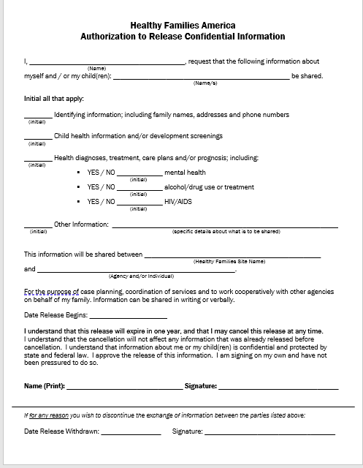
HFA Sample Consent Form
Notes:
An example of the HFA consent form. You can use this or your own BUT always make sure you compare to BPS and policy to ensure you have all required elements.

Slide 10
Governance and Administration
GA-3E-Participant Privacy and Voluntary Choice in Research: Self Study requires you to submit a narrative indicating whether or not your site is currently or previously involved in a research project in the past five years. Reminder review policy GA7-D for HFNY policy on research requirements and process to request participation in a research project.
Notes:
GA-3E-Participant Privacy and Voluntary Choice in Research: Self Study requires you to submit a narrative indicating whether or not your site is currently or previously involved in a research project in the past five years. Reminder review policy GA7-D for HFNY policy on research requirements. Reminder review policy GA7-D for HFNY policy on research requirements and process to request participation in a research project. Thanks to Claudia Miranda Julian for providing some boiler plate language that sites can use when submitting this documentation for the self study.

Slide 11
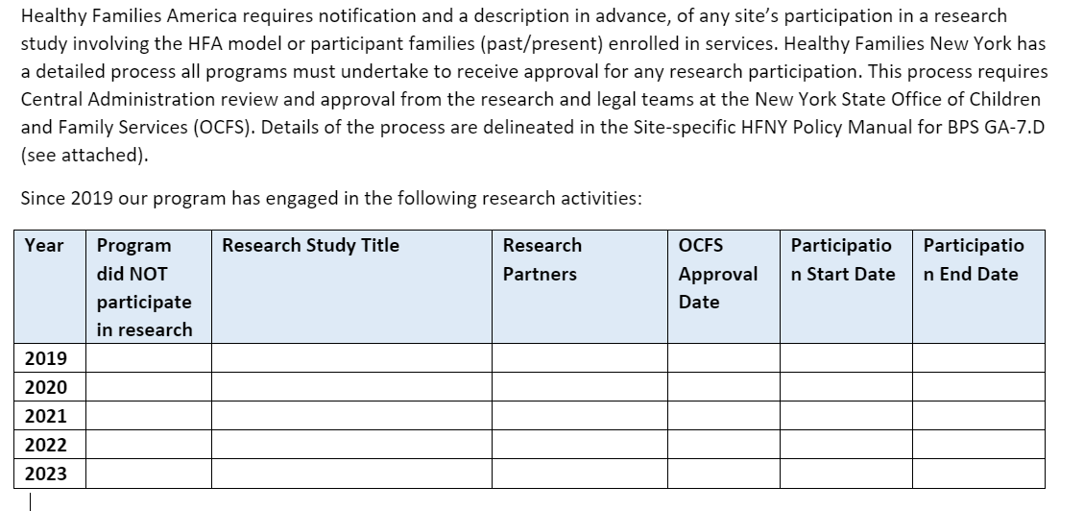
Governance and Administration Boiler Plate Language for Self Study
Notes:
Boiler plate language for research projects/studies. You can alter the template to state “since 2019 our program has NOT engaged in any research activities. We will send this out and post to the website under the Accreditation 101 number 8 so you have access to it.

Slide 12
Governance and Administration
GA-4A-Policy Criteria to Identify Child Abuse and Neglect: Safety Standard
This has been updated since the last BPS to include:
The site’s mechanism to track and follow up on all children with suspected abuse and neglect
Reporting all suspected cases of child abuse and neglect including situations where it is believed a report has already been made by another individual or organization
- These are in addition to the previous BPS requirements for the policy including:
having the criteria to identify and determine when to report suspected child abuse and neglect
expectation that all staff act as mandated reporters and are required to make reports when they suspect abuse or neglect
notification of the Program Manager or Supervisor when abuse or neglect is suspected.
Notes:
GA-4A-Policy Criteria to Identify Child Abuse and Neglect: Safety Standard
This has been updated since the last BPS to include some new components and changes to practice. Our policy includes the new requirements. Programs should make sure you are reviewing really closely with staff the policy and procedures so they are aware of their responsibilities. The new requirements include:
The site’s mechanism to track and follow up on all children with suspected abuse and neglect
Reporting all suspected cases of child abuse and neglect including situations where it is believed a report has already been made by another individual or organization
- These are in addition to the previous BPS requirements for the policy including:
having the criteria to identify and determine when to report suspected child abuse and neglect
expectation that all staff act as mandated reporters and are required to make reports when they suspect abuse or neglect
notification of the Program Manager or Supervisor when abuse or neglect is suspected.

Slide 13
Governance and Administration
GA-4C Suspected Child Abuse and Neglect Immediate Notification to Supervisors and Program Managers: Self Study requires you to submit a report of currently enrolled families where child abuse and neglect was suspected and reported to the proper authorities (SCR), documenting how safety concerns are addressed and appropriate follow through occurs
Submit MIS report
Submit Service Plans for currently enrolled families where child abuse and neglect was suspected and reported to the SCR. The Service Plan is the documentation to show how safety concerns are addressed and appropriate follow through occurs
Notes:
GA-4C Suspected Child Abuse and Neglect Immediate Notification to Supervisors and Program Managers: Self Study requires you to submit a report of currently enrolled families where child abuse and neglect was suspected and reported to the proper authorities (SCR), documenting how safety concerns are addressed and appropriate follow through occurs
We created a new MIS report to help you track families where a report was made to the SCR. In addition, the Service Plan will be used as the mechanism to capture the risks/safety concerns and the follow through. When submitting for your self study, you will submit the new MIS report and for currently enrolled families where child abuse and neglect was suspected and reported to the SCR, submit the Service Plans for the families to show the documentation how safety concerns are addressed and appropriate follow through occurs

Slide 14
Governance and Administration
GA-4C- Where are you documenting suspected cases of Child Abuse and Neglect?

Slide 15
Governance and Administration
GA-5A- Policy Participant Death and Grief Counseling- Self Study requires you to submit the policy.
GA-5B-Participant Death and Grief Counseling-Self Study requires you to submit a narrative indicating any incidents of participant death that have occurred within the past year.
Submit the Critical Incident Reports on any participant deaths. Ensure the reports are updated to include any additional information on the incident and/or support provided to the family.
Notes:
GA-5A- Policy Participant Death and Grief Counseling- Self Study requires you to submit the policy.
GA-5B-Participant Death and Grief Counseling-Self Study requires you to submit a narrative indicating any incidents of participant death that have occurred within the past year.
Submit the Critical Incident Reports on any participant deaths. Ensure the reports are updated to include any additional information on the incident and/or support provided to the family.

Slide 16
Governance and Administration
GA-6-Policy and Procedure Manual: Self Study requires you to submit the Policy and Procedure Manual including this policy indicating how updates to Policy and Procedure are communicated to all staff in a timely basis and that staff have access to a copy of the Policy and Procedure Manual.
Notes:
GA-6-Policy and Procedure Manual: Self Study requires you to submit the Policy and Procedure Manual including this policy indicating how updates to Policy and Procedure are communicated to all staff in a timely basis and that staff have access to a copy of the Policy and Procedure Manual.

Slide 17
Self Study Submission
What am I submitting January 5th?
Policies and Procedures
Annual Service Review and Equity Plan
Last completed Quarterly Reports for most recent 4 quarters (this will depend on contract start date)
July-2022-2023 quarters 3rd and 4th 2023-2024 1st and 2nd
September 2022-2023 quarters 2nd, 3rd and 4th and 2023-2024 1st
October 2022-2023 quarters 1-4
December 2022-2023 quarters 1-4
MIS Reports
Human Resources info (interview questions, job postings, resumes and staff development plans etc…)
Use Accreditation tool to see breakdown of self study submission by BPS and where to find the info; ASR, Quarterly Reports, MIS reports, HR
Notes:
Your self study will consist of the following information which you will be adding to the SharePoint as you complete these tasks.
Finalized Policies and Procedures (approved by PCM)
Annual Service Review and Equity Plan
Quarterly Reports for the last 4 completed quarters
MIS Reports (Accreditation tool will be updated to add report names for each self study section so you know what reports to include. You will want to run these and upload closer to the submission date of January 5th to get your most recent data for recent practice.
Human Resources info-standardized interview questions, job postings, staff resumes, and staff development plans if applicable
Use Accreditation tool to see breakdown of self study submission by BPS and where to find the info; ASR, Quarterly Reports, MIS reports, HR

Slide 18
QUESTIONS??

Slide 19
Questions on Self Study
For questions related to setting up an Outlook account to enable use of SharePoint, please reach out to Claudia Miranda-Julian.
Claudia.Miranda-Julian@ocfs.ny.gov
For questions related to interfacing with SharePoint, please reach out to your accreditation OCFS program contract manager.

Slide 20
Supporting Families
Right From the Start
Questions?
Allison.Contento@ocfs.ny.gov
Melanie.Schraa@ocfs.ny.gov
Suzan.Harry@ocfs.ny.gov

